Slide 1
FAKE NEWS PROJECT
Submitted by
KAYALVIZHI . P

Slide 2
AGENDA
Introduction
Problem Statemet
Problem Understanding
What is a Fake News?
EDA
Natural Language Processing
Stop Words Removal
Stemming
Lemmatization
Vectorizer
Model Building
Hyper Parameter Tuning

Slide 3
INTRODUCTION
Fake news detection is a subtask of text classification and is often defined as the task of classifying news as real or fake.
The term ‘fake news’ refers to the false or misleading information that appears as real news.
It aims to deceive or mislead people.
Fake news comes in many forms, such as clickbait (misleading headlines), disinformation (with malicious intention to mislead the public), misinformation (false information regardless of the motive behind), hoax, parody, satire, rumour, deceptive news and other forms as discussed in the literature [2].

Slide 4
PROBLEM STATEMENT
Fake news is a real problem in today’s world, and it has become more extensive and harder to identify.
A major challenge in fake news detection is to detect it in the early phase.
Another challenge in fake news detection is the unavailability or the shortage of labelled data for training the detection models.
We propose an effective labelling technique to address the label shortage problem.

Slide 5
PROBLEM UNDERSTANDING
Fake news has become one of the biggest problems of our age. It has serious impact on our online as well as offline discourse. One can even go as far as saying that, to date, fake news poses a clear and present danger to western democracy and stability of the society.

Slide 6
What is a Fake News?
Fake news's simple meaning is to incorporate information that leads people to the wrong path. Nowadays fake news spreading like water and people share this information without verifying it. This is often done to further or impose certain ideas and is often achieved with political agendas.
For media outlets, the ability to attract viewers to their websites is necessary to generate online advertising revenue. So it is necessary to detect fake news.

Slide 7
Exploratory Data Analysis (EDA)
Importing necessary libraries and importing two dataset fake and true as a data frame.
Then we are adding label to both the datasets.
Label 0 for fake,csv and Label 1 for True.csv.
We have two datasets so we are combining both datasets using concat funtion.
Checked some statistical information like shape, info, data types etc.
Then we are dropping unwanted columns from our dataset.
Checking for Null values. We don’t have any null values in our dataset. We will confirm it with heatmap also.
Checking some basic informations like columns, info.
After that we are done with NLP steps.
Then we are checking Skewness and correlation for our label variable only, because we are having only two columns in our dataset.
So that we don’t have any visualizations in our project.

Slide 8
NATURAL LANGUAGE PROCESSIG
Natural language processing (NLP) refers to the branch of computer science-and more specifically, the branch of artificial intelligence or AI-concerned with giving computers the ability to understand text and spoken words in much the same way human beings can.
Machine learning data only works with numerical features so we have to convert text data into numerical columns. So we have to preprocess the text and that is called natural language processing.
In-text preprocess we are cleaning our text by steaming, lemmatization, remove stopwords, remove special symbols and numbers, etc. After cleaning the data we have to feed this text data into a vectorizer which will convert this text data into numerical features.

Slide 9

Stop Words Removal
A Stop Word is a commonly used word in any natural language such as “a, an , the, for, is, was, which, are, were, from, do, with, and, so, very, that, this, no, yourselves etc....”.
These Stop Words will have a very high frequency and so these should be eliminated while calculating the term frequency so that the other important things are given priority.
Stop word removal is such a Pre-processing step which removes these stop words and thereby helping in the further steps and also reducing some processing time because the size of the document decreases tremendously.
Checking for Stopwords:

Slide 10
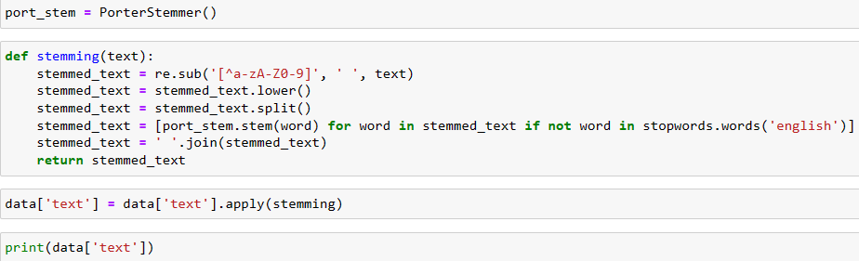
STEMMING
Stemming is a pre-processing step in Text Mining applications as well as a very common requirement of Natural Language processing functions. In fact it is very important in most of the Information Retrieval systems. The main purpose of stemming is to reduce different grammatical forms / word forms of a word like its noun, adjective, verb, adverb etc. to its root form. The goal of stemming is to reduce inflectional forms and sometimes derivationally related forms of a word to a common base form.

Slide 11
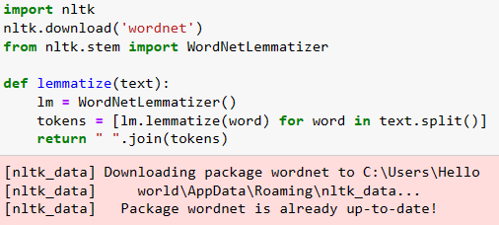

LEMMATIZATION
Lemmatization is a text normalization technique used in Natural Language Processing (NLP), that switches any kind of a word to its base root mode. Lemmatization is responsible for grouping different inflected forms of words into the root form, having the same meaning.

Slide 12

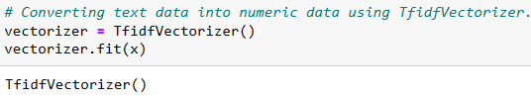

VECTORIZER
Vectorization is the process of converting words into numbers is called Vectorization.
Vectorization is a technique by which you can make your code execute fast.
It is a very interesting and important way to optimize algorithms when you are implementing it from scratch.
Vectorization is one of the most useful techniques to make your machine learning code more efficient.

Slide 13
Model Building
In this project Label is our target variable which is binary, where we need to predict whether the news is fake or real. From this I can conclude that it is a Classification type problem hence I have used following Classification algorithms.
After the pre-processing and data cleaning I was left with 2 columns only including target and I used these independent feature for model building and prediction. The algorithms used on training the data are as follows:
Logistic Regression
Decision Tree Classifier
KNNeighbors Classifier
Random Forest Classifier
Ada Boost Classifier
I have got the best random state and maximum R2 score and then created train test split to build the above models.

Slide 14
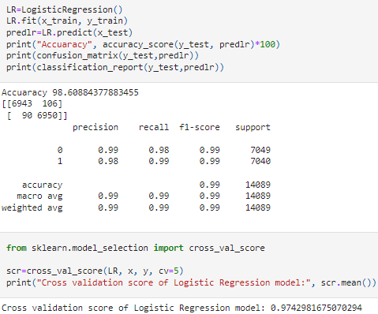
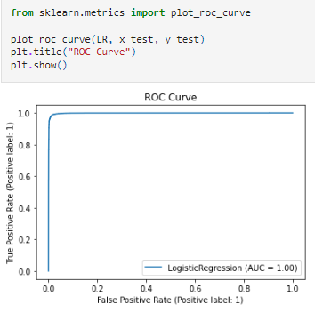
1. Logistic Regression

Slide 15
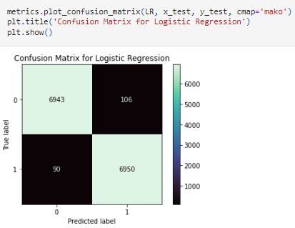
Created Logistic Regression model and checked for it's evaluation metrics. The model is giving accuracy_score as 98.6% and Cross validation Score as 97%.

Slide 16
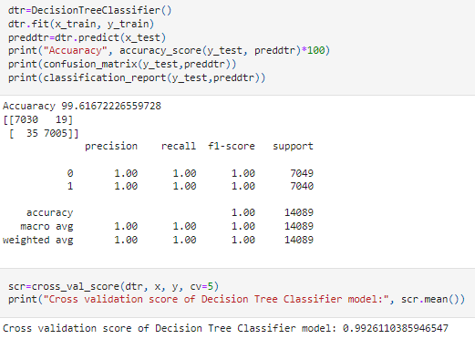
2. Decision Tree Classifier

Slide 17
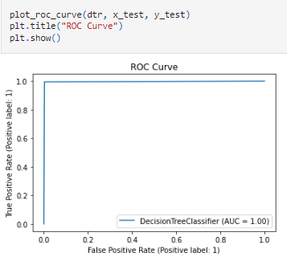
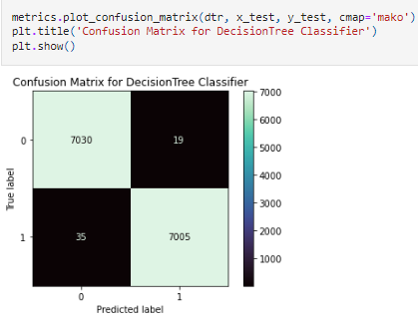
Created Decision Tree Classification model and checked for it's evaluation metrics. The model is giving accuracy_score as 99.6% and Cross validation Score as 99%.

Slide 18
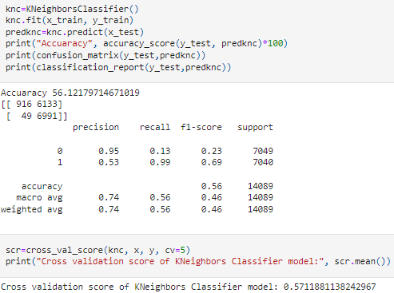
3. KNNeighbors Classifier

Slide 19
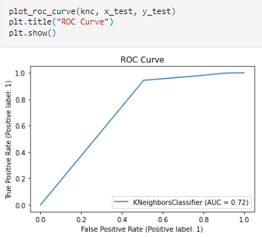
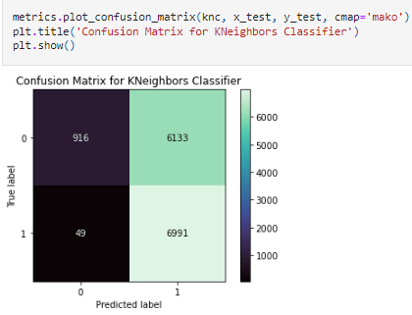
Created KNNeighbors Classification model and checked for it's evaluation metrics. The model is giving accuracy_score as 56.2% and Cross validation Score as 57%.

Slide 20
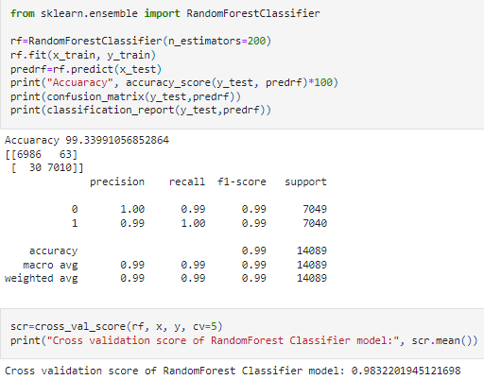
4. Random Forest Classifier

Slide 21
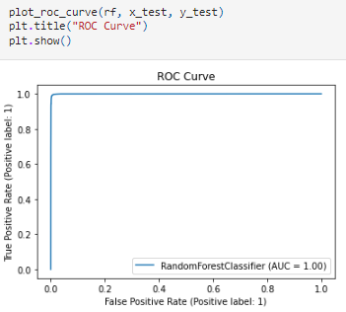
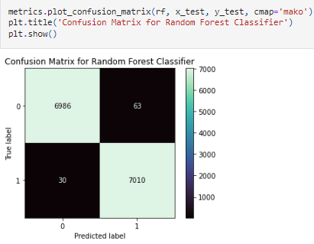
Created Random Forest Classification model and checked for it's evaluation metrics. The model is giving accuracy_score as 99.3% and Cross validation Score as 98%.

Slide 22
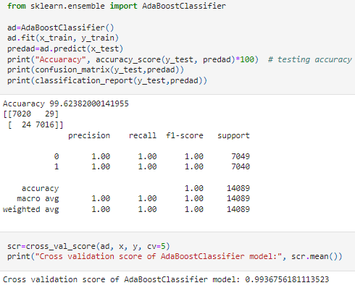
5. Ada Boost Classifier

Slide 23
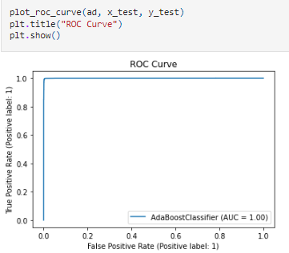
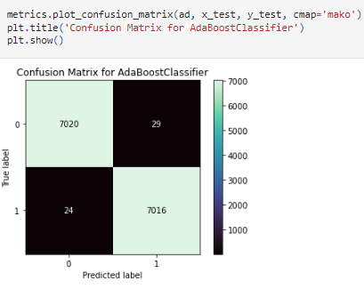
Created Ada Boost Classification model and checked for it's evaluation metrics. The model is giving accuracy_score as 99.6% and Cross validation Score as 99%.

Slide 24
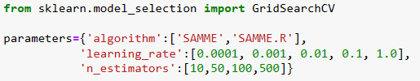
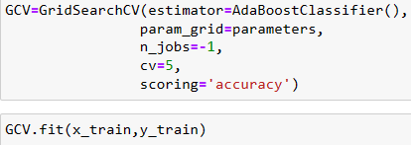
Hyper Parameter Tuning
I am choosing Ada Boost Classifier as my best model.
After comparing all the regression models I have selected AdaBoost Classifier as my best model and have listed down it's parameters above referring the sklearn webpage.

